Slide 1
SNR EEG Discussion
Resting state alpha power does not correlate with behavioral SNR measured by HINT, or hearing aid success (self report).
Alpha power in occipital lobe during auditory stimulation (clean ba’s) is associated with SNR-50, SNR-80, audibility (PTA) and aided “ease of communication”
(TBD)
SNR ERP (N1 amplitude and latency) is associated with SNR-50
SNR ERP is associated with alpha power during ERP

Slide 2
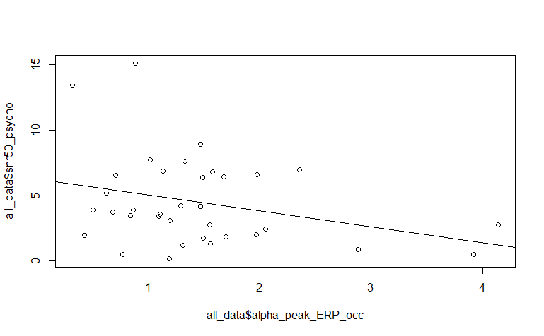
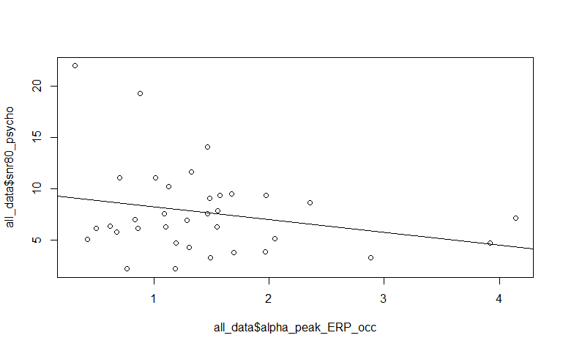
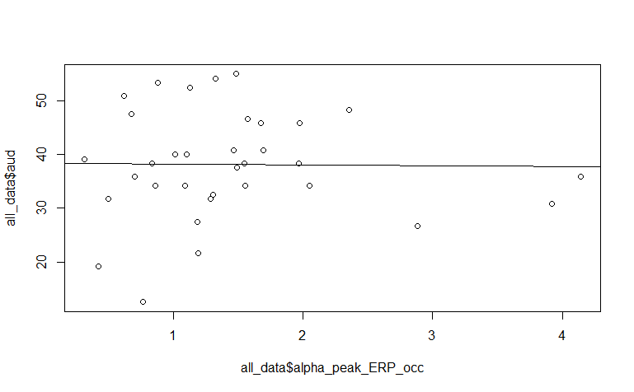
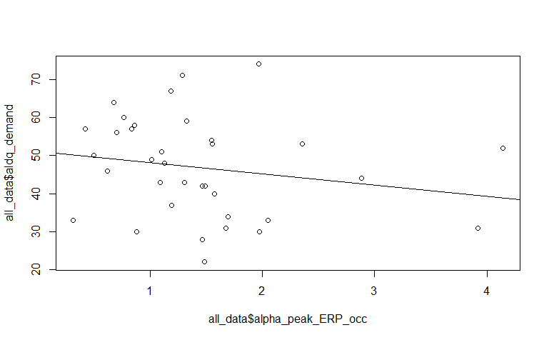
Alpha power during ERP (0-1.25 seconds post-stim)
lm(formula = alpha_peak_ERP_occ ~ snr50_psycho + aud + aphab_aided_global +
aldq_demand, data = all_data)
Residuals:
Min 1Q Median 3Q Max
-0.8702 -0.4872 -0.1289 0.1323 1.9823
Coefficients:
Estimate Std. Error t value Pr(>|t|)
(Intercept) 1.19180 0.91280 1.306 0.20160
snr50_psycho -0.14444 0.04826 -2.993 0.00549 **
aud 0.02283 0.01638 1.394 0.17352
aphab_aided_global 0.02939 0.01259 2.334 0.02649 *
aldq_demand -0.01933 0.01032 -1.873 0.07083 .
---
Signif. codes: 0 ‘***’ 0.001 ‘**’ 0.01 ‘*’ 0.05 ‘.’ 0.1 ‘ ’ 1
Residual standard error: 0.7337 on 30 degrees of freedom
Multiple R-squared: 0.3443, Adjusted R-squared: 0.2569
F-statistic: 3.939 on 4 and 30 DF, p-value: 0.01097
SNR 50
SNR 80
PTA
ALDQ_demand

Slide 3
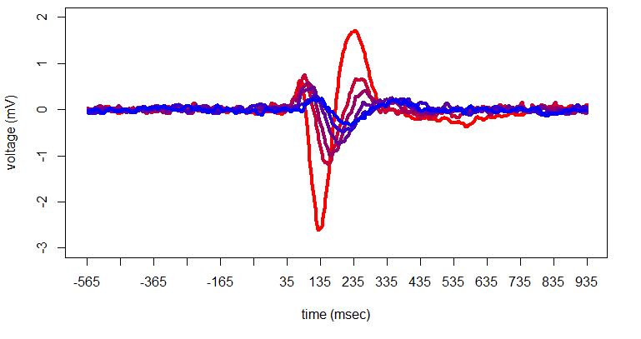
Grand Average ERP – SNR levels

Slide 5
OLD

Slide 6
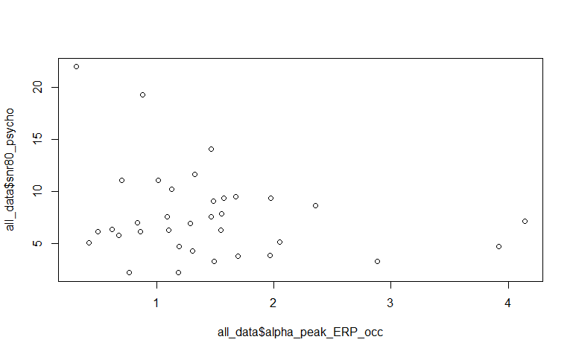
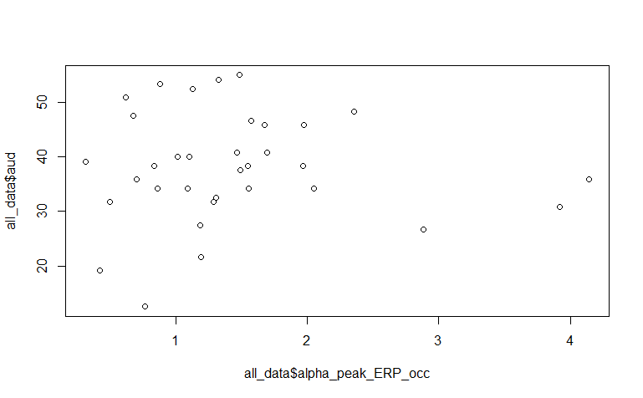
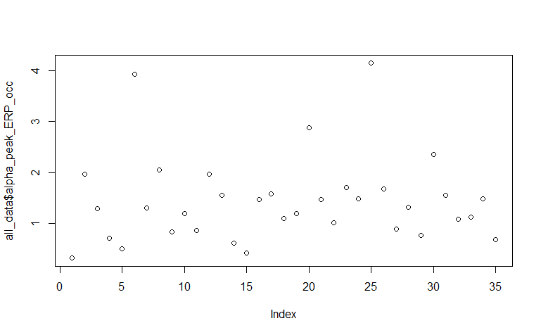

Slide 7
Alpha power during ERP (0-1.25 seconds post-stim)
Occipital channels (O1, O2, OZ)
lm(formula = alpha_peak_ERP_occ ~ alpha_power_peak_ratio + snr50_psycho +
aud + aphab_unaided_bn + aphab_unaided_rv + aphab_aided_ec,
data = all_data)
Residuals:
Min 1Q Median 3Q Max
-1.39946 -0.30176 0.05417 0.25763 1.96915
Coefficients:
Estimate Std. Error t value Pr(>|t|)
(Intercept) -0.769103 0.845549 -0.910 0.37080
alpha_power_peak_ratio 1.077239 0.526980 2.044 0.05044 .
snr50_psycho -0.161904 0.053808 -3.009 0.00549 **
aud 0.051091 0.018852 2.710 0.01135 *
aphab_unaided_bn 0.014189 0.010014 1.417 0.16753
aphab_unaided_rv -0.017753 0.009225 -1.925 0.06450 .
aphab_aided_ec 0.040025 0.016998 2.355 0.02578 *
---
Signif. codes: 0 ‘***’ 0.001 ‘**’ 0.01 ‘*’ 0.05 ‘.’ 0.1 ‘ ’ 1
Residual standard error: 0.7202 on 28 degrees of freedom
Multiple R-squared: 0.4102, Adjusted R-squared: 0.2838
F-statistic: 3.246 on 6 and 28 DF, p-value: 0.01504
APHAB
EC: Ease of communication
BN: Background Noise
RV: Reverberation
AV: Aversiveness scale
alpha_ERP[,c(9,10,31)]))

Slide 8
lm(formula = alpha_peak_ERP_occ ~ doso_global + dosoa_co + ssq12_score +
+sadl_pe + sadl_nf + sadl_pi + aldq_demand + aphab_unaided_ec +
aphab_unaided_bn + aphab_unaided_rv + aphab_unaided_av +
aphab_aided_ec + aphab_aided_rv + aphab_aided_bn + aphab_aided_av,
data = all_data)
Residuals:
Min 1Q Median 3Q Max
-1.11087 -0.34458 0.06311 0.34150 1.25105
Coefficients:
Estimate Std. Error t value Pr(>|t|)
(Intercept) 4.4304434 1.4720895 3.010 0.00721 **
doso_global 0.3702236 0.2884290 1.284 0.21472
dosoa_co -0.3862231 0.2322528 -1.663 0.11273
ssq12_score -0.1283152 0.1409422 -0.910 0.37401
sadl_pe -0.2623060 0.2836863 -0.925 0.36675
sadl_nf -0.0668854 0.1279741 -0.523 0.60726
sadl_pi 0.0637715 0.1961976 0.325 0.74870
aldq_demand -0.0244959 0.0101716 -2.408 0.02635 *
aphab_unaided_ec -0.0273988 0.0115137 -2.380 0.02796 *
aphab_unaided_bn 0.0004855 0.0133894 0.036 0.97146
aphab_unaided_rv 0.0002341 0.0094848 0.025 0.98056
aphab_unaided_av -0.0353410 0.0127083 -2.781 0.01191 *
aphab_aided_ec 0.0352024 0.0234658 1.500 0.15001
aphab_aided_rv 0.0071010 0.0111084 0.639 0.53030
aphab_aided_bn 0.0227551 0.0135630 1.678 0.10977
aphab_aided_av 0.0290895 0.0103525 2.810 0.01118 *
---
Signif. codes: 0 ‘***’ 0.001 ‘**’ 0.01 ‘*’ 0.05 ‘.’ 0.1 ‘ ’ 1
Residual standard error: 0.6912 on 19 degrees of freedom
Multiple R-squared: 0.6314, Adjusted R-squared: 0.3404
F-statistic: 2.17 on 15 and 19 DF, p-value: 0.05635
lm(formula = alpha_peak_ERP_occ ~ doso_global + dosoa_co + ssq12_score +
aphab_unaided_global + aphab_aided_global + sadl_pe + sadl_nf +
sadl_pi + aldq_demand, data = all_data)
Residuals:
Min 1Q Median 3Q Max
-0.91732 -0.54635 0.06517 0.33457 1.50224
Coefficients:
Estimate Std. Error t value Pr(>|t|)
(Intercept) 3.51208 1.43700 2.444 0.02192 *
doso_global 0.15469 0.26154 0.591 0.55952
dosoa_co -0.38743 0.21158 -1.831 0.07902 .
ssq12_score -0.08548 0.11538 -0.741 0.46570
aphab_unaided_global -0.03899 0.01504 -2.593 0.01569 *
aphab_aided_global 0.06740 0.02025 3.328 0.00271 **
sadl_pe -0.02445 0.25321 -0.097 0.92384
sadl_nf -0.08323 0.11874 -0.701 0.48981
sadl_pi 0.18024 0.16106 1.119 0.27376
aldq_demand -0.01954 0.01032 -1.892 0.07008 .
---
Signif. codes: 0 ‘***’ 0.001 ‘**’ 0.01 ‘*’ 0.05 ‘.’ 0.1 ‘ ’ 1
Residual standard error: 0.7237 on 25 degrees of freedom
Multiple R-squared: 0.4684, Adjusted R-squared: 0.277
F-statistic: 2.447 on 9 and 25 DF, p-value: 0.03733
APHAB
EC: Ease of communication
BN: Background Noise
RV: Reverberation
AV: Aversiveness scale

